Slide 1


Slide 2

Final Expense Presentation
Step 1: Introduction- One Call Close/Booking the Appointment
Hello Mr./Ms. _________(first name).
This is _____________. (your name), with Senior Resource Services
You requested some life insurance prices, and listed your birthdate as ___/___/___, correct?
Rebuttals: Not interested (a lot of my clients weren’t initially interested. Are you a smoker or non smoker?)
didn’t request (like you, a lot of my clients requested it a while ago, we’ve been backed up. Are you a smoker or non smoker?)/already have (Did you get approved with Americo?)
JUST LIKE THE CREEPY GUY AT THE BAR, REFUSE TO GIVE UP

Slide 3
Final Expense Presentation
Step 1: Introduction- One Call Close/Booking the Appointment
As we both know, it is very important that we get this taken care of for you.
I can set an appointment with you, or we can take a couple of minutes to take care of this right now. (Try to do a one call close, only take appointments if absolutely needed)
Grab a pen and paper please Mr/Ms ________
Notes for You
    Appointment- shoot for same day or next day appointment. Offer 2 times (ex. 9am or 1pm, etc) After they choose a time, move to step 2,
    Move on to step 2 NO MATTER WHAT
JUST LIKE THE CREEPY GUY AT THE BAR, REFUSE TO GIVE UP

Slide 4
Final Expense Presentation
Step 2: Credibility
Mr/Ms ___________(first name) please write down my name, _____________(your first & last names)
My National Producer Number is _____________.
Do you have a smartphone, like an iPhone or Android?.......... Great! I’m going to text you my Plan Enroll site with my information such as my picture, office address, and other info.
Verify they opened the link. It will help with credibility, as well as show how tech savvy they are

Slide 5
Final Expense Presentation
Step 3: Discovery- Why are they looking for life insurance?
Mr/Ms ___________(first name) what had you interested in final expense?
Dig into their WHY……it is the reason they want this, so listen, ask questions (ask about spouse/kids/grandkids, who will handle everything when they pass, etc) to get a full understanding. Use it throughout the rest of the presentation. Don’t move on too fast
Are you wanting to get enough coverage for your final arrangements only, or do you want enough coverage to leave some I Love You Money?

Slide 6
Final Expense Presentation
Step 4: The Process- 4 steps to getting approved
Mr./Ms. __________(First Name), I’m a medical field underwriter with access to all the major companies in the state.
As you know we don’t buy insurance, we have to apply for it.
So we need to go over a few questions to match you up with the company that will accept your health history, but also is affordable for your budget,
In order for us to submit an application based on what you want, we will need to do the following:

Slide 7
Final Expense Presentation
Step 4: The Process- 4 steps to getting approved
Step 1:
Complete a basic client profile such as name, address, phone number, email, etc to verify your basic info.
Have you moved in the last 6 years?

Slide 8
Final Expense Presentation
Step 4: The Process- 4 steps to getting approved
Step 2:
Companies will ask a few lifestyle questions, and check your driving record.
Do you have your driver’s license or ID with you?

Slide 9
Final Expense Presentation
Step 4: The Process- 4 steps to getting approved
Step 3:
Companies will need to verify your medical and prescription history. Are you familiar with the MIB Report?
I’m sure you remember back in the day you either took your medical records from one doctor to the next doctor, but you probably haven’t done that in a long time right?
That’s because your medical records are now in the MIB, which stands for Medical Information Bureau which is verified with your social.
Do you know your social or have your Social Security card handy?
Rebuttals: Not giving social (not only is tied to your medical records, but I’m sure you know you’re not the only person with your same name, so they can’t verify your medical records without it)

Slide 10
Final Expense Presentation
Step 4: The Process- 4 steps to getting approved
Step 4:
Lastly, is banking info. Companies want to verify 3 things.
If you get approved today, will you want to pay today or pick a payment date within the next 30 days?
They also want to make sure you’ll be using a valid bank account that is in your name. Is the account in your name?
Is it an online bank like MetaBank, Cash App, or Chime……or do you use a traditional bank or credit union such as Wells Fargo or Navy Fed?

Slide 11
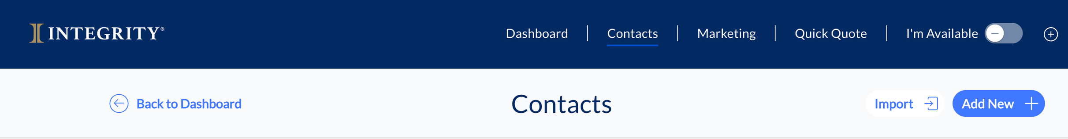
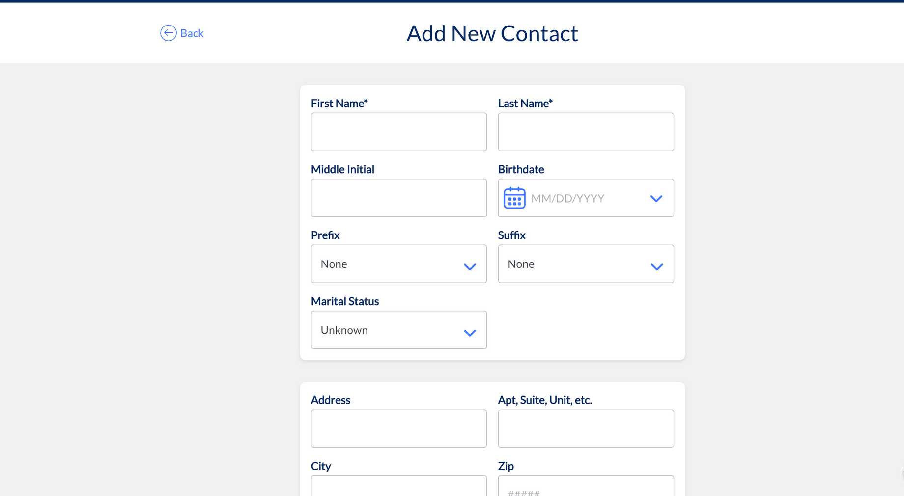
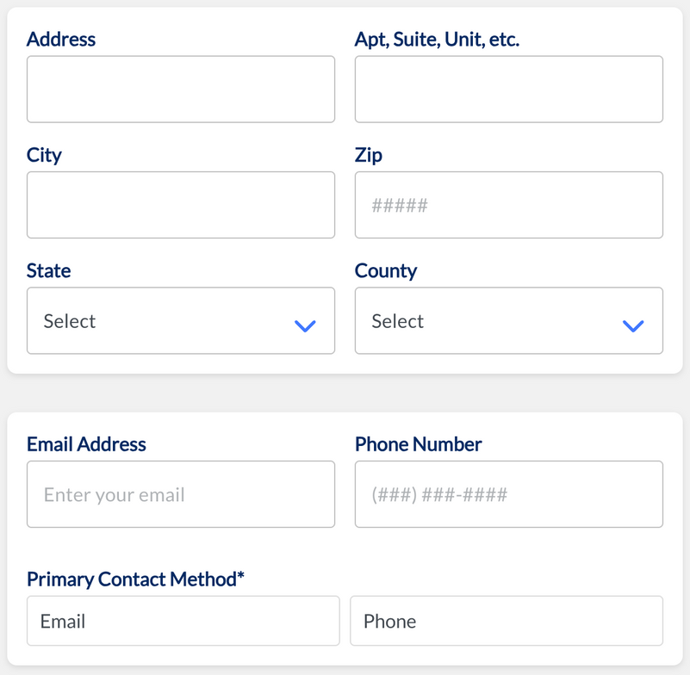
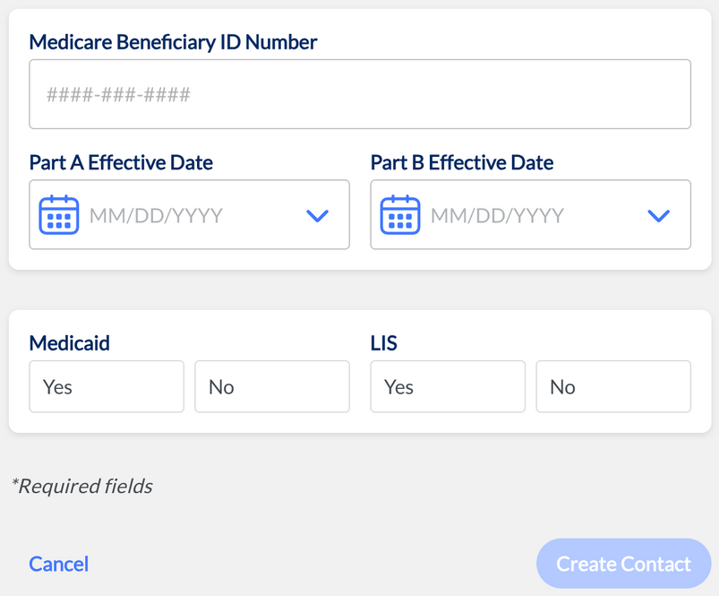
Final Expense Presentation
Step 5: Client Profile
Medicare number not required for life insurance

Slide 12
Final Expense Presentation
Final Expense Presentation
Step 5: Financial Profile- put in Integrity
Mr./Ms. __________(First Name) Now let’s move on to the Financial questions. This will help us make sure we’re able to design the best options for you so that you’re not under insured nor over insured. (put 1 & 2 in financial profile, & 3-6 in the client notes at the bottom of the contact profile on Integrity)
Do you rent or own your home? Mortgage/Rent Amount: $__________
Total Monthly Household Income? (all sources) $__________
Do you currently have any life insurance? Company__________ Coverage Amount $__________ Premium $__________
Do you have long term or home health care (Life Insurance Living Benefits can help with LTC/HHC)? Company__________
Do you have anything else that acts like life insurance, such as anything that transfers upon your death such as mutual funds, brokerage accounts, IRAs, Annuities, etc?
Who is your current Medicare company? (if they’re on Medicare, usually 65 or older)

Slide 13
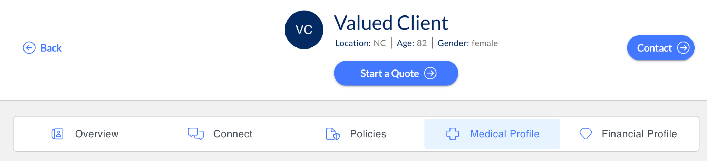
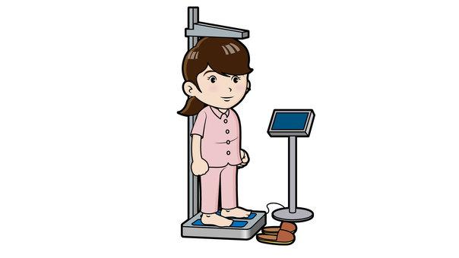



Final Expense Presentation
Step 6: Health Profile- put in Integrity
What is your height & weight?
Are you a tobacco user?
Who are your doctors (primary care physician & specialists)?
Let’s add your pharmacy & prescriptions

Slide 14

Do you have COPD, Emphysema, or any lung issues?
Do you have any brain or nervous disorders, such as alzheimer's, dementia, etc?
Do you have liver issues, lupus, etc?
Do you have any heart or circulatory issues such as congestive heart failure, stents, pacemaker, AFIB, etc?
Do you have stomach or digestive issues?
Do you have diabetes? Do you take insulin, & if so, how many units per day?
Do you have kidney disease or any other kidney issues?
In the last 5 years, have you had any in patient hospital stays or surgeries?
Do you have any history of internal cancer or tumors, or metastatic cancer?
Do you have osteoporosis that causes fractures, amputations due to disease, or any skeletal, muscular, or connective tissue disorders?
Do you have AIDS, HIV, or AIDS Related Complex?

Slide 15
Final Expense Presentation
Step 7: Present 3 options
Mr./Ms. __________(First Name), like a lot of my clients, I’m going to guess that you don’t want one of those policies that costs $400 a month, right?
So most of my clients fall into 1 of 2 categories. They are either:
  Benefit Focused- meaning you want $15,000 or $20,000 of coverage, etc., what’s the cheapest coverage you qualify for based on your health
Or
  Budget Focused- meaning I can’t spend more than $100 a month $150 a month whatever it may be, what’s the most coverage I can get for that hundred dollars again based on my health and everything

Slide 16
Final Expense Presentation
Step 7: Present 3 options
So would you say your benefit focused or budget focused? Great, what’s that number? (referring to the coverage goal or budget they’re looking for)
I have a few options for you to write down
  Please write Gold, Silver, & Bronze and leave some space by each one for some more info
  Beside gold write $$$ of coverage, beside silver write $$ of coverage, beside bronze write $ coverage
  Beside the Gold $$$ of coverage write $$$ per month, beside the silver $$ of coverage write $$ per month, and basic the Bronze $ of coverage write $ per month
If we can get you approved today, then which one best fits your goals, Gold, Silver, or Bronze?

Slide 17
Final Expense Presentation
Step 8: Reaffirm their Decision/Address Their Concerns
If they are fully confident in their decision
Mr./Ms. __________(First Name) the _____________(gold/silver/bronze) sounds like a great choice to meet your goals. I’m opening the application now, and it should only take a few minutes to complete. It usually takes a few days or more to get a decision, but in some rare cases we could know at the end of the application
If they are unsure address concerns
If it’s the cost the suggest they drop down to silver or bronze etc
They don’t want to give their info for the app (social, banking etc) then reaffirm the reasons why they need it, and if they want coverage then the company will need this info just like their car insurance company needed it.

Slide 18
Final Expense Presentation
Step 9: Apply through Integrity LifeCenter
Mr./Ms. __________(First Name) I’m already most of the way through the application. It should only be a few more minutes. Please make sure you have your driver’s license, social, routing & account number handy.
App completed. Download it to save to their profile in Max, then do one of the following:
  Approved- let them know they were approved and be on the lookout for that policy within the next 10 business days
  Sent to underwriting- remind them it takes a few days or so to get a response, and you will stay in touch with them via text, emails, or calls to keep them updated. Reach out to let them know the results and get extra info if requested by carrier
  Declined- remind them it takes a few days or so to get a response, and you will stay in touch with them via text, emails, or calls to keep them updated. Do research to see who you can get the approved with. Reach back out when you’re ready.

Slide 19
Final Expense Presentation
Step 10: Submit Business
Create and save their profile in Max
Submit their business in max, copy the confirmation code, and save in their max profile
****optional- send a thank you card, client gift, etc

