Slide 1
IUL Presentation
For
Remote Video & Telesales
Appointments

Slide 2
10 step sales presentation (overview)
Introduction-booking the appointment/setting up one call close
Credibility - verification card/business card/verify my underwriter link
Discovery you die tomorrow who takes care of the home, who do you need to protect, if it’s an IUL, do they need it for coverage or growing money?
The process-medical field underwriter asking a lot of medical questions and finance questions to make sure we match you up with the company and product that best fit you were health and financial goals. You can’t buy you have to apply and we’re going to submit an application based on what you want.
Financial inventory/health inventory. For AUL’s and mortgage protection instead of asking for the budget I ask what they save every month so I can reverse engineer it.
Underwriting-for FEX use integrity, for IUL use Underwriting guides/cheat sheet
Present the three options that you drew up for their menu
Reaffirm and address concerns
Do the application
Submit business to (required) optional you can send a client gift or thank you card

Slide 3
IUL Presentation
Step 1: Introduction- Booking the Appointment
Script
Hello Mr./Ms. _________(first name). How are you? (Pause)
My name is _____________. You requested IUL quotes, and listed your birthdate as ___/___/___, correct?
As we both know, it is very important that we get this taken care of for you. I can set an appointment with you, or we can take a couple of minutes to take care of this right now. Can you grab a pen and paper?
Appointment- shoot for same day or next day appointment. Offer 2 times (ex. 9am or 1pm, etc) After they choose a time, add it to your calendar, move to step 2, then you’re done until your appointment.
They’re ready now- move to step 2

Slide 4
IUL Presentation
Step 2: Credibility- who you are
Mr./Ms. __________(First Name) I’m going to give you my information to verify who I am. Can you receive texts on this number? Is it a smartphone, such as an iPhone or Android, so I can text you a link?
Smartphone- Text them your agent verification link (if they have a smartphone)
Can receive texts, but NOT a smartphone- text them a picture of your agent verification card/business card
Can’t receive texts- Ask them to write down your name, phone number, & NPN

Slide 5
IUL Presentation
Step 3: Discovery- Why they are looking for an IUL
Mr./Ms. __________(First Name) most of my clients are looking for IULs for one of two reasons:
They protection focused, & want an IUL to get a large permanent death benefit that is usually cheaper than whole life. Or
They growth focused, and want to use an IUL to grow as much risk free money as possible so they can be their own bank or have a tax free retirement. A general rule of thumb is you want to invest at least 10 times your age, & in a perfect world 5% to 10% of your income.
Which one is your goal?
Protection Focused= Americo Instant IUL or MoO IUL Express or F & G Everlast IUL
Growth Focused= F & G Pathsetter IUL

Slide 6
IUL Presentation
Step 4: The Process- Next steps to get you approved
Mr./Ms. __________(First Name), I’m a medical field underwriter with access to all the major companies in the state. As you know we don’t buy insurance, we have to apply for it. So we need to go over a few questions to match you up with the company that best fits your health and financial goals, so we can submit the application based on what you want. So we will need to do the following:
Complete a basic client profile such as name, address, phone number, email, etc to verify your basic info
Ask a few lifestyle questions, do you skydive, race cars, etc. So we need to know, do you have an active driver’s license?
We will need to ask a few health and prescription questions. For that we will need to pull your info from your MIB (Medical Information Bureau) Report, which requires your social. Do you know it or have your social security card handy?
Lastly, these companies have to pay to get your records, so they want to make sure of two things
To prevent fraud, they will want to know if you have an active account that is in your name & there isn’t somebody else trying to take a policy out on you.
You have intent to pay for the policy if we can get you approved. Do you only use an online bank such as Metabank, CashApp, or Chime, or do you use a traditional bank or credit union?

Slide 7
IUL Presentation
Step 5: Personal & Financial- Put in their Integrity Profile
Mr./Ms. __________(First Name) I have a handful of financial questions, and a handful of health questions so that we can get you matched with the best option for you.
Let’s start with the Basic Info (go to contact details on Integrity)
Correct Spelling of your legal first & last names, suffix etc
Date of Birth
Primary contact (phone or email)
Email address
Phone number
Address, city, state, zip, county

Slide 8
IUL Presentation
Step 5 (continued): Personal & Financial Inventory- Put in their Integrity Profile
Mr./Ms. __________(First Name) Now let’s move on to the Financial questions. This will help us make sure we’re able to design the best options for you. (go to client notes at the bottom of the contact profile on Integrity)
Do you rent or own your home? Mortgage/Rent Amount: $__________
Total Monthly Household Income? (all sources) $__________
Total Monthly Expenses? $__________
How much money do you save each month? $__________
Do you have anything else that acts like life insurance, such as anything that transfers upon your death such as mutual funds, brokerage accounts, IRAs, Annuities, etc?

Slide 9
IUL Presentation
Step 5 (continued): Personal & Financial Inventory- Put in their Integrity Profile
If they’re protection focused
Most of my protection focused clients fall into one of two categories:
They are either benefit focused, “I need $100,000 of coverage” or they are budget focused, “I can’t spend more than $100 per month”. Are you benefit focused or budget focused? …….What’s that number? (meaning their coverage goal or budget)
If they’re growth focused
Most of my growth focused clients invest at least 10 times their age, & often times want to invest more, but we don’t want to disrupt our lifestyle.
What is the LEAST amount of money you can comfortably invest into this policy each month?

Slide 10
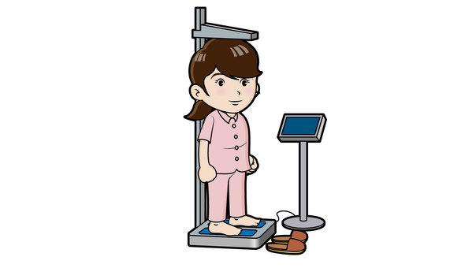
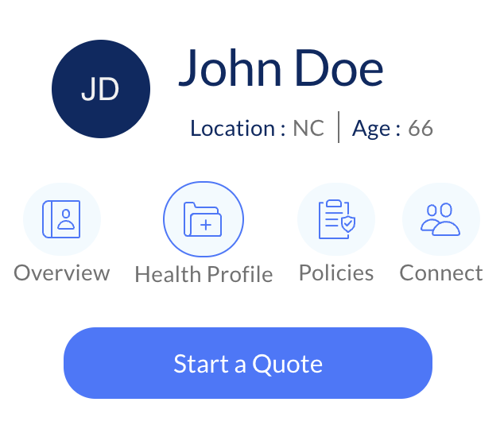
IUL Presentation
Step 6: Health Underwriting- Put info into their Integrity Profile
Let’s go over some basic health info.
What is your height & weight?
Are you a tobacco user?
Who are your doctors (primary care physician & specialists)?
Let’s add your pharmacy & prescriptions

Slide 11
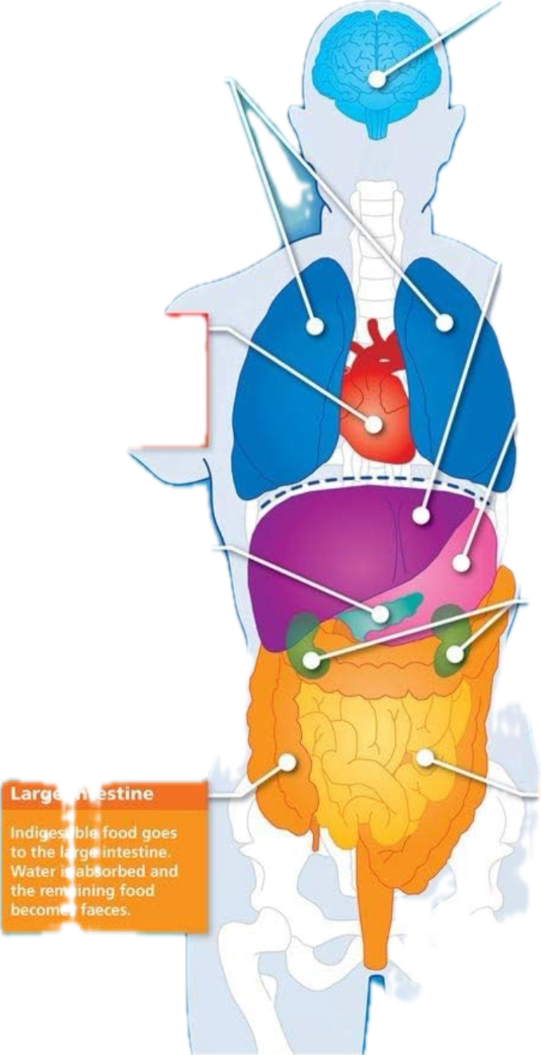
IUL Presentation
Step 6 (continued): Health Underwriting- Put info into their Integrity Profile
Do you have COPD, Emphysema, or any lung issues?
Do you have any brain or nervous disorders, such as alzheimer's, dementia, etc?
Do you have liver issues, lupus, etc?
Do you have any heart or circulatory issues such as congestive heart failure, stents, pacemaker, AFIB, etc?
Do you have stomach or digestive issues?
Do you have diabetes? Do you take insulin, & if so, how many units per day?
Do you have kidney disease or any other kidney issues?
In the last 5 years, have you had any in patient hospital stays or surgeries?
Do you have any history of internal cancer or tumors, or metastatic cancer?
Do you have osteoporosis that causes fractures, amputations due to disease, or any skeletal, muscular, or connective tissue disorders?

Slide 12
IUL Presentation
Step 7: Present options-Menu
If they are PROTECTION FOCUSED
Mr./Ms. __________(First Name) I have a few options for you to write down
Please write Gold, Silver, & Bronze and leave some space by each one for some more info
Beside gold write $$$ of coverage, beside silver write $$ of coverage, beside bronze write $ coverage
Beside the Gold $$$ of coverage write $$$ per month, beside the silver $$ of coverage write $$ per month, and basic the Bronze $ of coverage write $ per month
If we can get you approved today, then which one best fits your goals, Gold, Silver, or Bronze?

Slide 13
IUL Presentation
Step 7: Present options-Illustration
If they are GROWTH FOCUSED
Mr./Ms. __________(First Name) I have drawn an illustration for your. We are going to go over the features of this product such as:
The increasing face amount
How you can never lose money
What kind of growth you can expect year over year
How you draw money from your IUL tax free to be your own bank, & have a tax free retirement
I am going to text you a link so I can share my screen (send a link for Google Meet, Zoom etc)
Once they are on the call, share your screen & go over the illustration

Slide 14
IUL Presentation
Step 8: Reaffirm & Address Concerns
PROTECTION FOCUSED
If they are fully confident in their decision
Mr./Ms. __________(First Name) the _____________(gold/silver/bronze) sounds like a great choice to meet your goals. I’m opening the application now, and it should only take a few minutes to complete. It usually takes a few days or more to get a decision, but in some rare cases we could know at the end of the application
If they are unsure address concerns
If it’s the cost the suggest they drop down to silver or bronze etc
They don’t want to give their info for the app (social, banking etc) then reaffirm the reasons why they need it, and if they want coverage then the company will need this info just like their car insurance company needed it.

Slide 15
IUL Presentation
Step 8: Reaffirm & Address Concerns
GROWTH FOCUSED
If they are fully confident in their decision
Mr./Ms. __________(First Name) the _____________(Product Name) sounds like a great choice to meet your goals. I’m opening the application now, and it should only take a few minutes to complete. It usually takes a few days or more to get a decision, and of course I’ll keep you up to date throughout the process
If they are unsure address concerns
If it’s the cost the suggest they drop down to the minimum they said they could invest, or switch to a protection focused IUL
They don’t want to give their info for the app (social, banking etc) then reaffirm the reasons why they need it, and if they want coverage then the company will need this info just like their car insurance company needed it.

Slide 16
IUL Presentation
Step 9: Application- Go to carrier site to do app
Mr./Ms. __________(First Name) I’m already most of the way through the application. It should only be a few more minutes. Please make sure you have your driver’s license, social, routing & account number handy.
App completed. Download it to save to their profile in Max, then do one of the following:
Approved- let them know they were approved and be on the lookout for that policy within the next 10 business days
Sent to underwriting- remind them it takes a few days or so to get a response, and you will stay in touch with them via text, emails, or calls to keep them updated. Reach out to let them know the results and get extra info if requested by carrier
Declined- remind them it takes a few days or so to get a response, and you will stay in touch with them via text, emails, or calls to keep them updated. Do research to see who you can get the approved with. Reach back out when you’re ready.

Slide 17
IUL Presentation
Step 10: Submit Business
Create and save their profile in Max
Submit their business in max, copy the confirmation code, and save in their max profile
****optional- send a thank you card, client gift, etc

