Slide 1
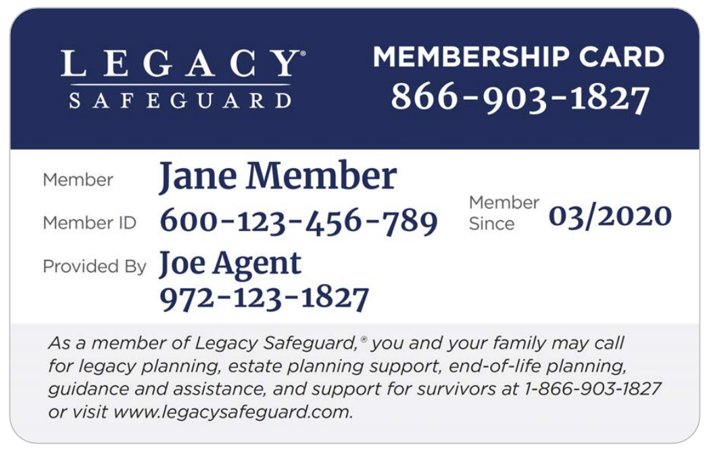
Legacy Safeguard
FEX Telesales
Presentation

Slide 2
Legacy Safeguard Final Expense Presentation
Step 1: Introduction- Booking the Appointment
Script
Hello Mr./Ms. _________(first name). How are you? (Pause)
My name is _____________. I helped you with your ____________(company) medicare plan.
Since you work with us, you qualify for the FREE Legacy Safeguard. It’ll only take a couple of minutes to set it up. We can set an appointment, or take a few minutes right now.
Appointment- shoot for same day or next day appointment. Offer 2 times (ex. 9am or 1pm, etc) After they choose a time, move to step 2, then you’re done until your appointment.
They’re ready now- move to step 2

Slide 3
Legacy Safeguard Final Expense Presentation
Step 2: Legacy Safeguard- what is it
Mr./Ms. __________(First Name) Legacy Safeguard is a free program that allows you to do your planning for your final arrangements. I have it on myself.
It helps you pre-plan for that sad day when you’re not here, all the way down to what to do to take care of your pets when you’re not here anymore
It allows you to have your final wishes shared with your loved ones so it makes that chaotic sad time much easier to manage
It attaches to your life insurance, so it makes filing the claim a seamless easy process
I’m going to get you enrolled now. Let me know when you get that email

Slide 4
Legacy Safeguard Final Expense Presentation
Step 3: Discovery- What is their current life insurance
Mr./Ms. __________(First Name) now that we’ve got you enrolled in your free Legacy Safeguard. I need to put a few notes in.
Who is your current life insurance with?
How much coverage do you have?
How much do they charge you every month?
See if you can make it cheaper than their current coverage
If you can’t make it cheaper than fill in the gaps. Most people planned their life insurance based on what the prices were when their parents passed away not when they are going to pass away.
Explain which option you’re going to try to accomplish (Cheaper or fill gaps)

Slide 5
Legacy Safeguard Final Expense Presentation
Step 3: Discovery- Why they are looking for life insurance
Mr./Ms. __________(First Name) most of the people I help are looking for final expense for one of two reasons:
They want enough coverage for their final arrangements only Or
They want to cover their final arrangements & leave some money behind to help out their spouse, kids, or grandkids
Which one is your goal?
Final arrangements only ($25k or less)= FEX
Final arrangements & Leave money behind=
$40k or less & below average health= FEX
$25k-$50k & average health/healthy = MoO IULE
$50k-$450k & average health/healthy = Americo Instant IUL

Slide 6
Legacy Safeguard Final Expense Presentation
Step 4: The Process- Next steps to get you approved
Mr./Ms. __________(First Name), I’m a medical field underwriter with access to all the major companies in the state. As you know we don’t buy insurance, we have to apply for it. So we need to go over a few questions to match you up with the company that best fits your health and financial goals, so we can submit the application based on what you want. So we will need to do the following:
Complete a basic client profile such as name, address, phone number, email, etc to verify your basic info
Ask a few lifestyle questions, do you skydive, race cars, etc. So we need to know, do you have an active driver’s license?
We will need to ask a few health and prescription questions. For that we will need to pull your info from your MIB (Medical Information Bureau) Report, which requires your social. Do you know it or have your social security card handy?
Lastly, these companies have to pay to get your records, so they want to make sure of two things
To prevent fraud, they will want to know if you have an active account that is in your name & there isn’t somebody else trying to take a policy out on you.
You have intent to pay for the policy if we can get you approved. Do you only use an online bank such as Metabank, CashApp, or Chime, or do you use a traditional bank or credit union?

Slide 7
Legacy Safeguard Final Expense Presentation
Step 5: Personal & Financial- Put in their Integrity Profile
Mr./Ms. __________(First Name) I have a handful of financial questions, and a handful of health questions so that we can get you matched with the best option for you.
Let’s start with the Basic Info (go to contact details on Integrity)
Correct Spelling of your legal first & last names, suffix etc
Date of Birth
Primary contact (phone or email)
Email address
Phone number
Address, city, state, zip, county
Medicare, Medicaid, & LIS info not required for Life Insurance***

Slide 8
Legacy Safeguard Final Expense Presentation
Step 5 (continued): Personal & Financial Inventory- Put in their Integrity Profile
Mr./Ms. __________(First Name) Now let’s move on to the Financial questions. This will help us make sure we’re able to design the best options for you. (go to client notes at the bottom of the contact profile on Integrity)
Do you rent or own your home? Mortgage/Rent Amount: $__________
Total Monthly Household Income? (all sources) $__________
Do you currently have any life insurance? Company__________ Coverage Amount $__________ Premium $__________
Do you have long term or home health care (Life Insurance Living Benefits can help with LTC/HHC)? Company__________
Do you have anything else that acts like life insurance, such as anything that transfers upon your death such as mutual funds, brokerage accounts, IRAs, Annuities, etc?
Who is your current Medicare company? (if they’re on Medicare, usually 65 or older)

Slide 9
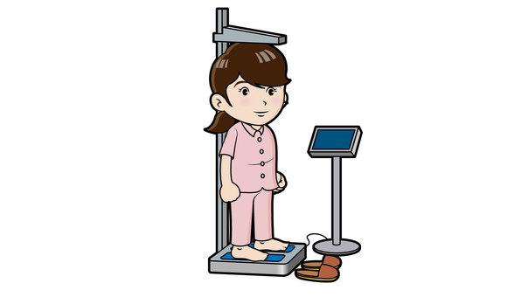
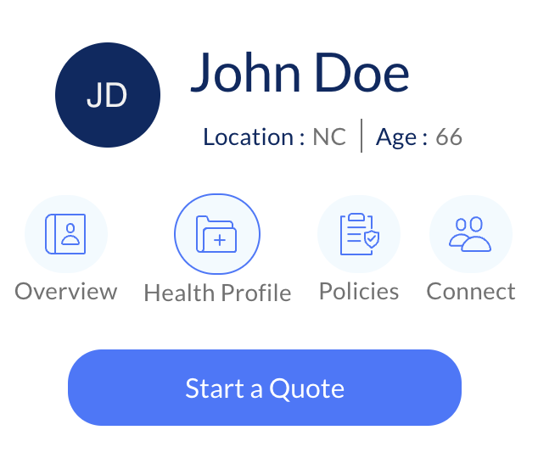
Legacy Safeguard Final Expense Presentation
Step 6: Health Underwriting- Put info into their Integrity Profile
Let’s go over some basic health info.
What is your height & weight?
Are you a tobacco user?
Who are your doctors (primary care physician & specialists)?
Let’s add your pharmacy & prescriptions

Slide 10
Legacy Safeguard Final Expense Presentation
Step 6 (continued): Health Underwriting- Put info into their Integrity Profile
Do you have COPD, Emphysema, or any lung issues?
Do you have any brain or nervous disorders, such as alzheimer's, dementia, etc?
Do you have liver issues, lupus, etc?
Do you have any heart or circulatory issues such as congestive heart failure, stents, pacemaker, AFIB, etc?
Do you have stomach or digestive issues?
Do you have diabetes? Do you take insulin, & if so, how many units per day?
Do you have kidney disease or any other kidney issues?
In the last 5 years, have you had any in patient hospital stays or surgeries?
Do you have any history of internal cancer or tumors, or metastatic cancer?
Do you have osteoporosis that causes fractures, amputations due to disease, or any skeletal, muscular, or connective tissue disorders?

Slide 11
Legacy Safeguard Final Expense Presentation
Step 7: Present three options-Menu
Mr./Ms. __________(First Name), a lot of my clients fall into 1 of 2 categories. They are either
Benefit Focused- meaning you want $15,000 or $20,000 of coverage, etc., what’s the cheapest coverage you qualify for based on your health
or
Budget Focused- meaning I can’t spend more than $100 a month $150 a month whatever it may be, what’s the most coverage I can get for that hundred dollars again based on my health and everything
So would you say your benefit focused or budget focused? Great, what’s that number?
I have a few options for you to write down
Please write Gold, Silver, & Bronze and leave some space by each one for some more info
Beside gold write $$$ of coverage, beside silver write $$ of coverage, beside bronze write $ coverage
Beside the Gold $$$ of coverage write $$$ per month, beside the silver $$ of coverage write $$ per month, and basic the Bronze $ of coverage write $ per month
If we can get you approved today, then which one best fits your goals, Gold, Silver, or Bronze?

Slide 12
Legacy Safeguard Final Expense Presentation
Step 8: Reaffirm & Address Concerns
If they are fully confident in their decision
Mr./Ms. __________(First Name) the _____________(gold/silver/bronze) sounds like a great choice to meet your goals. I’m opening the application now, and it should only take a few minutes to complete. It usually takes a few days or more to get a decision, but in some rare cases we could know at the end of the application
If they are unsure address concerns
If it’s the cost the suggest they drop down to silver or bronze etc
They don’t want to give their info for the app (social, banking etc) then reaffirm the reasons why they need it, and if they want coverage then the company will need this info just like their car insurance company needed it.

Slide 13
Legacy Safeguard Final Expense Presentation
Step 9: Application- Go to carrier site to do app
Mr./Ms. __________(First Name) I’m already most of the way through the application. It should only be a few more minutes. Please make sure you have your driver’s license, social, routing & account number handy.
App completed. Download it to save to their profile in Max, then do one of the following:
Approved- let them know they were approved and be on the lookout for that policy within the next 10 business days
Sent to underwriting- remind them it takes a few days or so to get a response, and you will stay in touch with them via text, emails, or calls to keep them updated. Reach out to let them know the results and get extra info if requested by carrier
Declined- remind them it takes a few days or so to get a response, and you will stay in touch with them via text, emails, or calls to keep them updated. Do research to see who you can get the approved with. Reach back out when you’re ready.

Slide 14
Legacy Safeguard Final Expense Presentation
Step 10: Submit Business
Create and save their profile in Max
Submit their business in max, copy the confirmation code, and save in their max profile
****optional- send a thank you card, client gift, etc

