Slide 1
Mortgage Protection Presentation
For
Remote Video & Telesales
Appointments

Slide 2
10 step sales presentation (overview)
Introduction-booking the appointment/setting up one call close
Credibility - verification card/business card/verify my underwriter link
Discovery you die tomorrow who takes care of the home, who do you need to protect, if it’s an IUL, do they need it for coverage or growing money?
The process-medical field underwriter asking a lot of medical questions and finance questions to make sure we match you up with the company and product that best fit you were health and financial goals. You can’t buy you have to apply and we’re going to submit an application based on what you want.
Financial inventory/health inventory. For AUL’s and mortgage protection instead of asking for the budget I ask what they save every month so I can reverse engineer it.
Underwriting-for FEX use integrity, for IUL use Underwriting guides/cheat sheet
Present the three options that you drew up for their menu
Reaffirm and address concerns
Do the application
Submit business to (required) optional you can send a client gift or thank you card

Slide 3
Mortgage Protection Presentation
Step 1: Introduction- Booking the Appointment
Script
Hello Mr./Ms. _________(first name). How are you? (Pause)
My name is _____________. You requested some mortgage protection insurance, and listed your mortgage company as _______________, is that correct?
As we both know, it is very important that we get this taken care of for you. I can set an appointment with you, or we can take a couple of minutes to take care of this right now. Can you grab a pen and paper?
Appointment- shoot for same day or next day appointment. Offer 2 times (ex. 9am or 1pm, etc) After they choose a time, add it to your calendar, move to step 2, then you’re done until your appointment.
They’re ready now- move to step 2

Slide 4
Mortgage Protection Presentation
Step 2: Credibility- who you are
Mr./Ms. __________(First Name) I’m going to give you my information to verify who I am. Can you receive texts on this number? Is it a smartphone, such as an iPhone or Android, so I can text you a link?
Smartphone- Text them your agent verification link (if they have a smartphone)
Can receive texts, but NOT a smartphone- text them a picture of your agent verification card/business card
Can’t receive texts- Ask them to write down your name, phone number, & NPN

Slide 5
Mortgage Protection Presentation
Step 3: Discovery- Why they are looking for Mortgage Protection
Mr./Ms. __________(First Name) what would be the plan if you didn’t have mortgage protection, and got sick or passed away? For example, would your spouse be able to pay the mortgage, or will they have to sell the house and downsize, do a reverse mortgage, etc.?
There are a few options people typically choose from, depending on their goals, health history, age, & budget. I’m going to go over them briefly now.
All of these products will have a death benefit and living benefits (explain to client)
IUL- pays off all or some of the mortgage, but is more costly, and can be harder to qualify for based on health concerns & age. A great option for permanent coverage, grow cash value, & provide living benefits
CBO- term that pays all or some of the mortgage, It costs a little more than regular term, but at the end of the term you get all your money back, so in the end you were covered for free.
Payment Protector- covered for a term, at the end you don’t get anything back, but it’s the cheapest form of coverage. With the payment protector, if you pass away, instead of paying out a large death benefit, it pays your monthly mortgage payment for the rest of the term
Equity Protection aka Critical Period- More popular for people 65 and older, provides 6 to 24+ months of mortgage payments, which allows you to grieve & avoid making a major decision until you’re not mentally and emotionally ready. This allows time so you can protect the equity in your home, allowing you to refinance, do a reverse mortgage, or have time to sell the house if that is your goal.

Slide 6
Mortgage Protection Presentation
Step 4: The Process- Next steps to get you approved
Mr./Ms. __________(First Name), I’m a medical field underwriter with access to all the major companies in the state. As you know we don’t buy insurance, we have to apply for it. So we need to go over a few questions to match you up with the company that best fits your health and financial goals, so we can submit the application based on what you want. So we will need to do the following:
Complete a basic client profile such as name, address, phone number, email, etc to verify your basic info
Ask a few lifestyle questions, do you skydive, race cars, etc. So we need to know, do you have an active driver’s license?
We will need to ask a few health and prescription questions. For that we will need to pull your info from your MIB (Medical Information Bureau) Report, which requires your social. Do you know it or have your social security card handy?
Lastly, these companies have to pay to get your records, so they want to make sure of two things
To prevent fraud, they will want to know if you have an active account that is in your name & there isn’t somebody else trying to take a policy out on you.
You have intent to pay for the policy if we can get you approved. Do you only use an online bank such as Metabank, CashApp, or Chime, or do you use a traditional bank or credit union?

Slide 7
Mortgage Protection Presentation
Step 5: Personal & Financial- Put in their Integrity Profile
Mr./Ms. __________(First Name) I have a handful of financial questions, and a handful of health questions so that we can get you matched with the best option for you.
Let’s start with the Basic Info (go to contact details on Integrity)
Correct Spelling of your legal first & last names, suffix etc
Date of Birth
Primary contact (phone or email)
Email address
Phone number
Address, city, state, zip, county

Slide 8
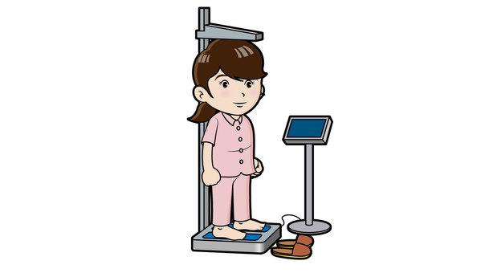
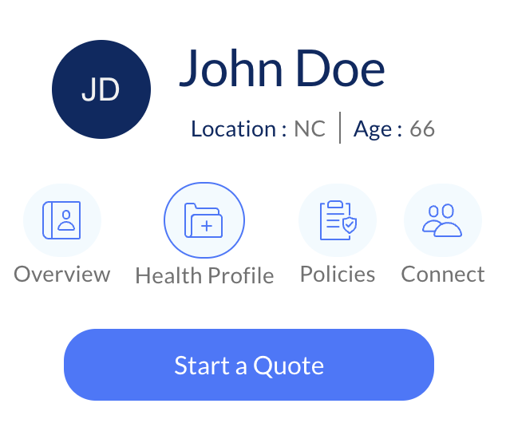
Mortgage Protection Presentation
Step 5: Health Underwriting- Put info into their Integrity Profile
Let’s go over some basic health info.
What is your height & weight?
Are you a tobacco user?
Who are your doctors (primary care physician & specialists)?
Let’s add your pharmacy & prescriptions

Slide 9
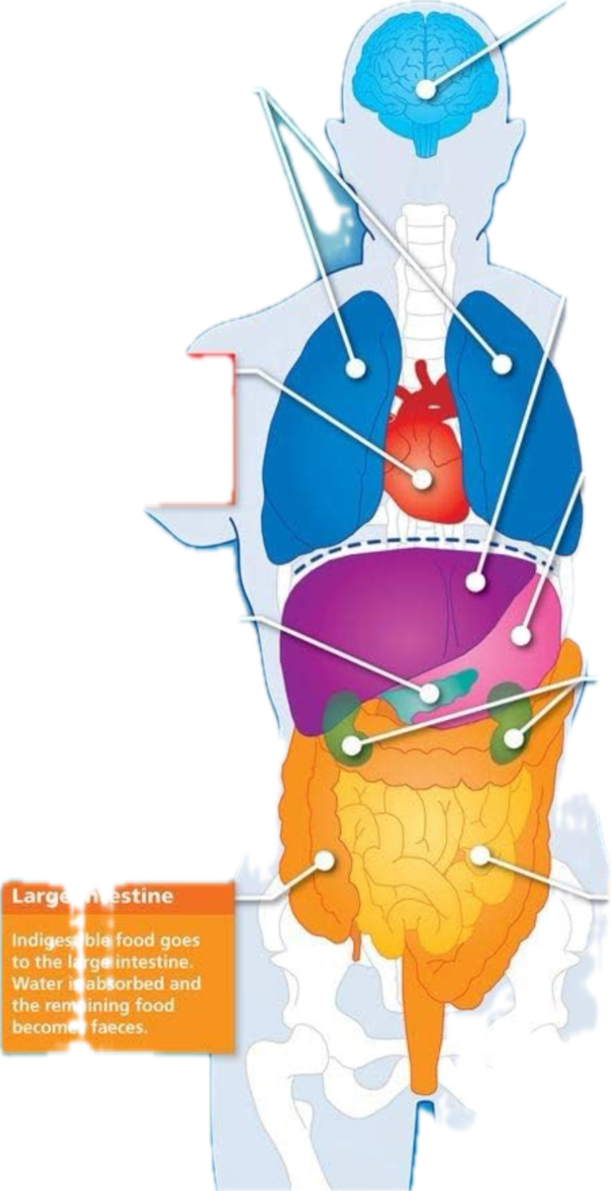
Mortgage Protection Presentation
Step 5 (continued): Health Underwriting- Put info into their Integrity Profile
Do you have COPD, Emphysema, or any lung issues?
Do you have any brain or nervous disorders, such as alzheimer's, dementia, etc?
Do you have liver issues, lupus, etc?
Do you have any heart or circulatory issues such as congestive heart failure, stents, pacemaker, AFIB, etc?
Do you have stomach or digestive issues?
Do you have diabetes? Do you take insulin, & if so, how many units per day?
Do you have kidney disease or any other kidney issues?
In the last 5 years, have you had any in patient hospital stays or surgeries?
Do you have any history of internal cancer or tumors, or metastatic cancer?
Do you have osteoporosis that causes fractures, amputations due to disease, or any skeletal, muscular, or connective tissue disorders?

Slide 10
Mortgage Protection Presentation
Step 6 (continued): Personal & Financial Inventory- Put in their Integrity Profile
Mr./Ms. __________(First Name) Now let’s move on to the Financial questions. This will help us make sure we’re able to design the best options for you. (go to client notes at the bottom of the contact profile on Integrity)
How long is your mortgage (ex. 30 years) ? __________
Monthly Mortgage Amount: $__________
Total Monthly Household Income? (all sources) $__________
Total Monthly Expenses? $__________
How much money do you save each month? $__________
Do you have anything else that acts like life insurance, such as anything that transfers upon your death such as mutual funds, brokerage accounts, IRAs, Annuities, etc?

Slide 11
Mortgage Protection Presentation
Step 6 (continued): Personal & Financial Inventory- Put in their Integrity Profile
Mortgage Payoff
Most of my mortgage payoff clients are either benefit focused, “I need $_________(amount of their mortgage) of coverage”, what’s the cheapest plan I qualify for based on my health?
or
they are budget focused, “I can’t spend more than $100 or $200 per month” What’s the most coverage I can get for that $100 or $200?
Are you benefit focused or budget focused? …….What’s that number? (meaning their coverage goal or budget)
Equity Protection
Most of my equity protection clients are either benefit focused, “I need $25,000 of coverage” what’s the cheapest plan I qualify for based on my health
or
they are budget focused, “I can’t spend more than $100 per month” What’s the most coverage I can get for that
Are you benefit focused or budget focused? …….What’s that number? (meaning their coverage goal or budget)

Slide 12
Mortgage Protection Presentation
Step 7: Present options-Menu
If they want Mortgage Payoff
Mr./Ms. __________(First Name) I have a few options for you to write down
At the top of your paper write $_____ of coverage & living benefits for all products.
Please write IUL, CBO, & Payment Protector and leave some space by each one for some more info
Beside IUL write permanent coverage, beside CBO write _____ years of coverage & get all your money back, & beside Term/Payment Protector write _____ years of coverage
Beside the IUL write $_____ per month, beside the CBO write $_____ per month, and beside Payment Protector write $______ per month
If we can get you approved today, then which one best fits your goals, IUL, CBO, or Term/Payment Protector?

Slide 13
Mortgage Protection Presentation
Step 7: Present options-Menu
If they need EQUITY PROTECTION (Simplified Issue Whol Life)
Mr./Ms. __________(First Name) I have a few options for you to write down
Please write Gold, Silver, & Bronze and leave some space by each one for some more info
Beside gold write $$$ of coverage, beside silver write $$ of coverage, beside bronze write $ coverage
Beside the Gold $$$ of coverage write $$$ per month, beside the silver $$ of coverage write $$ per month, and basic the Bronze $ of coverage write $ per month
If we can get you approved today, then which one best fits your goals, Gold, Silver, or Bronze?

Slide 14
Mortgage Protection Presentation
Step 8: Reaffirm & Address Concerns
If they are fully confident in their decision
Mr./Ms. __________(First Name) the _____________(IUL/CBO/Payment Protector…or Gold/Silver/Bronze for Equity Protection) sounds like a great choice to meet your goals. I’m opening the application now, and it should only take a few minutes to complete. It usually takes a few days or more to get a decision, but in some rare cases we could know at the end of the application
If they are unsure address concerns
If it’s the cost the suggest they drop down the face amount, or to Term or Payment Protector etc
They don’t want to give their info for the app (social, banking etc) then reaffirm the reasons why they need it, and if they want coverage then the company will need this info just like their car insurance company needed it.

Slide 15
Mortgage Protection Presentation
Step 9: Application- Go to carrier site to do app
Mr./Ms. __________(First Name) I’m already most of the way through the application. It should only be a few more minutes. Please make sure you have your driver’s license, social, routing & account number handy.
App completed. Download it to save to their profile in Max, then do one of the following:
Approved- let them know they were approved and be on the lookout for that policy within the next 10 business days
Sent to underwriting- remind them it takes a few days or so to get a response, and you will stay in touch with them via text, emails, or calls to keep them updated. Reach out to let them know the results and get extra info if requested by carrier
Declined- remind them it takes a few days or so to get a response, and you will stay in touch with them via text, emails, or calls to keep them updated. Do research to see who you can get the approved with. Reach back out when you’re ready.

Slide 16
Mortgage Protection Presentation
Step 10: Submit Business
Create and save their profile in Max
Submit their business in max, copy the confirmation code, and save in their max profile
****optional- send a thank you card, client gift, etc

